Slide 1
Student Online Teaching Advice Notice
The materials and content presented within this session are intended solely for use in a context of teaching and learning at Trinity.
Any session recorded for subsequent review is made available solely for the purpose of enhancing student learning.
Students should not edit or modify the recording in any way, nor disseminate it for use outside of a context of teaching and learning at Trinity.
Please be mindful of your physical environment and conscious of what may be captured by the device camera and microphone during videoconferencing calls.
Recorded materials will be handled in compliance with Trinity’s statutory duties under the Universities Act, 1997 and in accordance with the University’s policies and procedures.
Further information on data protection and best practice when using videoconferencing software is available at https://www.tcd.ie/info_compliance/data-protection/.
© Trinity College Dublin 2020
CS7CS6- Research and Innovation Methods. Gaye.stephens@tcd.ie

Slide 2
CS7CS6: Research and Innovation Methods
Assignment
Research Plan
Critique
2021-2022
Gaye Stephens gaye.stephens@tcd.ie

Slide 3
Excerpt From the assignment sheet
Individually submit the following
Reflection on the process and outputs of the team work. (approx. 250 words)
b. Critique of the research described in the dissertation assigned to your group. Based on lecture notes, learning
from the group assignment processes and marking scheme for your dissertation, each student should determine
the categories for critique. (max 500 words)
c. Reflection on the process and outputs of the individual work. (approx 250 words)
8. For your individual MSc research project, submit a research plan captured in a set of 6 slides providing the following information
i. research canvas (as per template given in class)
ii. motivation statement (approx. 150 words)
iii. list of at least 7 references which support your research idea, method and motivation
iv. research project Gantt chart
v. an explanation of whether or not you require to get ethical approval for your research.
vi. list technical and research skills you have or hope to develop to carry out your research project.
Examples of research plans are available on Blackboard.

Slide 4
Student Name: | Student ID: | Stream: | Supervisor Name:
Research Question/Aim
2. Research Objectives |  | 3. Approach/Method to achieve objectives
4. Evaluation
5. Contribution of your research project.
Research Canvas

Slide 5
In addition to the Research Canvas include the following 5 items in your research plan
Item | Description
1. Motivation Statement | Text that describes why you are motivated to answer your research question. (approx. 150 words).
2. Gantt Chart | The gantt chart should indicate when you are going to carry out the various steps of your research.
3. Skills list | List both the technical and research skills you intend to develop during your research.
4. Reference List | At least 7 selected References. Together, these 7 references should support your motivation, approach/method and evaluation. Use your preferred referencing style.
5. Ethics statement: | Indicate by saying yes or no if you need to make an ethics application. Provide a reason(s) for your decision.

Slide 6
CS7CS6 – Literature to Support the research Plan
Use literature to
Support your motivation for answering the research question. Use data to support/give context to the motivation e.g. X amount of people in Ireland have a hearing difficulty, X amount of images are reported on in the health service each year, X amount of polls on politicians before elections have been unreliable….
Provide definitions of concepts, terms used in your question e.g. improve, quality, efficiency, medical images, social media, action games- Make sure that every term in your question is defined.
Back up The method you are choosing to answer your question e.g. examples of how others have answered question of your type in your domain.
Provide some relevant background material on the state of the art and historical context and how your questions fits into this context (be mindful about how concepts change over time)
Describe particular work that you are building on, if relevant e.g. previous project, specific experiment, specific paper.
Choose the papers carefully to fit in with what you propose to do. Think of your references as a collective and have a good balance in the collective (sources, purpose for inclusion, stakeholder perspectives, contemporary/historical)

Slide 7
Student Name: | Student ID: | Stream: | Supervisor Name:
1. Research Question/AIM: To develop a system to monitor home heating that improves data quality and usefulness
2. Research Objectives Understand current home heating monitoring systems. Discover what functionality users want in a home heating monitoring systems Establish the current data quality and usefulness measurements for the best home heating monitoring systems Create a new system |  | 3. Approach/Method to achieve objectives Literature review to find Current designs of home heating monitoring systems Definitions of data quality and usefulness for home heating monitoring systems Measurements of data quality for home heating monitoring systems User satisfaction surveys for home heating monitoring systems User requirements gathering techniques Technology reviews e.g. sensors, software development. Engage with users, using techniques chosen from literature, to discover user requirements Design a system based on findings from the literature and user engagement Build a system using technology based on literature review and available resources. Design a System usability survey based on literature findings.
4. Evaluation Let the users use the system for a set time Compare the quality of the data collected with the quality of the data already available from other systems. Compare the usefulness of your system with other systems
5. Contribution Comparison tables for data quality and usefulness

Slide 8
Student Name: | Student ID: | Stream: | Supervisor Name:
1. Research Question/AIM: What are the challenges of developing home heating monitoring systems?
2. Research Objectives Understand current home heating monitoring systems. Focus on a particular stakeholder. Establish the current challenges users have with home heating monitoring systems Create a new system to highlight solutions to the challenges |  | 3. Approach/Method to achieve objectives Literature review to find Current designs of home heating monitoring systems Current challenges for all stakeholders User satisfaction surveys for home heating monitoring systems Technology reviews e.g. sensors, software development. Choose a stakeholder perspective Engage with stakeholders to understand their challenges. Design a system based on findings from the literature and stakeholder engagement Build a targeted prototype to address the challenges using technology based on literature review and available resources.
4. Evaluation Demonstrate the targeted prototype to the stakeholder Survey the stakeholder to collect their views the new system.
5. Contribution List of challenges of home heating systems from a particular stakeholder perspective Targeted, evaluated prototype to demonstrate potential solutions to these challenges

Slide 9
Research Objectives
Research Objectives are statements of what you want to achieve.
Action Verbs are used to specify Research objectives e.g. Understand, Determine, Verify, Describe, Compare, Analyse.
They are not moving targets- They should be derived from the Research Aim/Question.
Approach/Method to achieve objectives
What you will do to achieve the objectives e.g. literature review, interview, survey, measure, compare, build, design….

Slide 10

CS7CS6 –Scoping a research question.
Consider ways in which the scope of a research question could be Determined
If required, reduce or increase the scope of your MSc research project.
Determine resources/skills required to answer the question
Determine what resources/skills are available
Partnership with your supervisor……
Map out the steps involved in answering the question- Can the steps be sensibly grouped into phases?
Can you place the work in a particular context that reduces the scope e.g. Technical context, Use context, business context, population context, geographical context?

Slide 11
Indicative Rubric
Percentage Mark | Research Plan (50%) | Research Canvas (50%) | Presentation
>70% | The work is comprehensive showing detail of the planned work on a Gantt chart. Excellent understanding demonstrated on activities involved in completion and presentation of the research e.g. ethical approval, dissertation planning, research and technical skills development References are from excellent sources and are used to support a mix of motivation, domain, research approach, evaluation and technology. Clear motivation aligned to the aims of the research the student has demonstrated significant innovation and/or insights | There is alignment between the objectives and Method/approach on the research canvas. Evaluation aligned with the research aim. Research aim and contribution aligned. There is coherence between the information on the research canvas and the Gantt chart. Clear motivation aligned to the aims of the research | Excellent quality of English. Excellent presentation of the material i.e. Gantt chart clear, references formatted well
>60% | The work is comprehensive but not backed up with a detailed plan. Some understanding demonstrated on combination of activities required to complete and present a research project. Some activities may be missing or poorly aligned with others. References are included but may be from sub optimal sources or not of the required mix i.e. to support a mix of motivation, domain, research approach, evaluation and technology. A research motivation is included but may not be adequately aligned to the research aim. | There is alignment between the objectives and Method/approach on the research canvas. There is coherence between the information on the research canvas and the Gantt chart. Research aim and contribution may not be aligned. Evaluation may not be aligned with research aim Clear motivation aligned to the aims of the research | Good quality of English. Good presentation of the material i.e. Gantt chart clear, references formatted well.
>50% | The content is not comprehensive e.g. very high level objectives, generic details used on the Gantt chart. Poor understanding of the combination of activities required to complete and present a research project. Some activities may be missing or poorly aligned with others. More of a focus on building a piece of technology rather than answering a research question. The motivation statement may be a description of the domain rather than addressing why the student thinks it is a good piece of research to undertake. References are from poor sources, not a good breadth (i.e. covering motivation, domain, research approach, evaluation, technology) | Lack of coherence between objectives, approach, evaluation, aim, motivation and/or contribution. Lack of alignment between Gantt chart and research canvas. Clear motivation but it may not be aligned to the research aim. There may be scoping issues. | Adequate quality of English. Adequate presentation of the material

Slide 12
CS7CS6 – Critiquing papers and dissertations
Some pointers to support the critique of the dissertation assigned to your group. Will also support your critique of papers.
Context for the Critique
Critiquing preparation and criteria
Marking schemes

Slide 13
CS7CS6 – Critiquing papers and dissertations
Context for the Critique

Slide 14
CS7CS6 - Dissertations
Why
So, What
A Dissertation ….
Academic document that presents the
Background
Process
Methods
Findings
and motivation
in order to situate and answer a research question
And thereby demonstrate the writer’s mastery of a topic
What
When
How
Who
Where

Slide 15
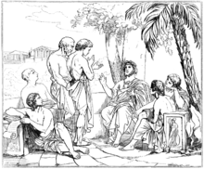
CS7CS6 – Asking research questions
This is not something new
?
“Good Questioners tend to be aware of, and be quite comfortable in, their own ignorance”
A more Beautiful question- The power of inquiry to spark breakthrough ideas, Warren Berger, 2014
https://en.wikipedia.org/wiki/Plato

Slide 16

CS7CS6 – Research Communities
Standing on the Shoulders of Giants
and leave behind a good foundation for others to continue to build.
http://www.cs.virginia.edu/~robins/YouAndYourResearch.html
https://austinstartups.com/standing-on-the-shoulders-of-giants-keeping-austins-future-bright-part-2-5a92d9c4e816
Website/photo credit: https://www.garycarmell.com/standing-on-shoulders-of-giants/

Slide 17
CS7CS6 – Building on/Recognising others work
Combining ideas from other researchers
Make Sure you use Citations
Testing others’ ideas
Using Others’ Methods
Understand and avoid plagiarism
Looking at the teams others have formed around them- are there any new trends?
Look at what others did- see can it be refashioned for a different context
Advancing others’ ideas
https://libguides.tcd.ie/plagiarism/calendar

Slide 18
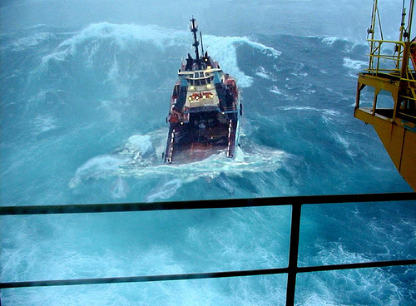
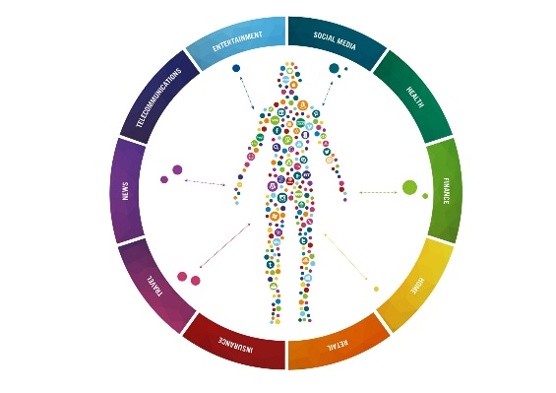
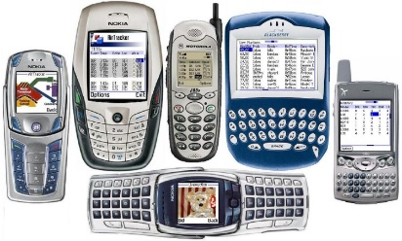

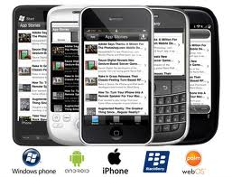
CS7CS6– NOW- The Perfect Storm
“We have the “perfect storm”- unlimited computing power(cloud server farms), remarkable biosensors, genome sequencing, imaging capabilities, health information systems, ubiquity of smart phones, bandwidth, pervasive connectivity, social networking. Super convergence” Eric Topol
Data
Information
Protection
Ecosystems
Machine learning
Knowledge Management
Networking
Graphics
Data science
https://www.ics.ie/news/view/1656
https://medium.com/the-internet-of-me/the-internet-of-me-an-infographic-340d87658994
? ? ? ? ? ? ? ? ? ? ? ? ? ? ? ? ? ? ? ? ? ? ? ? ? ? ? ? ? ? ? ? ?

Slide 19
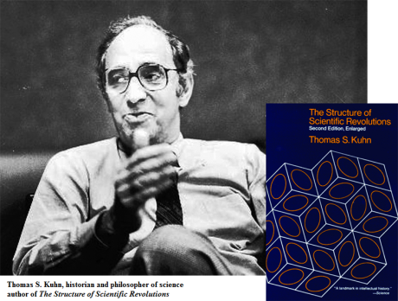

CS7CS6 – Thomas Kuhn(1922-1996)- Paradigm Shifts
The Structure of Scientific Revolutions (1962; second edition 1970; third edition 1996; fourth edition 2012)

Slide 20
CS7CS6– Thomas Kuhn- Paradigm Shifts
“Kuhn's central claim is that a careful study of the history of science reveals that development in any scientific field happens via a series of phases. The first he christened "normal science" – business as usual, if you like. In this phase, a community of researchers who share a common intellectual framework – called a paradigm or a "disciplinary matrix" – engage in solving puzzles thrown up by discrepancies (anomalies) between what the paradigm predicts and what is revealed by observation or experiment. Most of the time, the anomalies are resolved either by incremental changes to the paradigm or by uncovering observational or experimental error. As philosopher Ian Hacking puts it in his terrific preface to the new edition of Structure: "Normal science does not aim at novelty but at clearing up the status quo. It tends to discover what it expects to discover.“
………….
The trouble is that over longer periods unresolved anomalies accumulate and eventually get to the point where some scientists begin to question the paradigm itself. At this point, the discipline enters a period of crisis characterised by, in Kuhn's words, "a proliferation of compelling articulations, the willingness to try anything, the expression of explicit discontent, the recourse to philosophy and to debate over fundamentals". In the end, the crisis is resolved by a revolutionary change in world-view in which the now-deficient paradigm is replaced by a newer one. This is the paradigm shift of modern parlance and after it has happened the scientific field returns to normal science, based on the new framework. And so it goes on.”
Thomas Kuhn: the man who changed the way the world looked at science
https://www.theguardian.com/science/2012/aug/19/thomas-kuhn-structure-scientific-revolutions

Slide 21
CS7CS6– Thomas Kuhn- Paradigm Shifts
“The most intriguing idea, however, is to use Kuhn's thinking to interpret his own achievement. In his quiet way, he brought about a conceptual revolution by triggering a shift in our understanding of science from a Whiggish paradigm to a Kuhnian one, and much of what is now done in the history and philosophy of science might be regarded as "normal" science within the new paradigm.
……..But already the anomalies are beginning to accumulate. Kuhn, like Popper, thought that science was mainly about theory, but an increasing amount of cutting-edge scientific research is data- rather than theory-driven. And while physics was undoubtedly the Queen of the Sciences when Structure… was being written, that role has now passed to molecular genetics and biotechnology. Does Kuhn's analysis hold good for these new areas of science? And if not, isn't it time for a paradigm shift?”
Thomas Kuhn: the man who changed the way the world looked at science
https://www.theguardian.com/science/2012/aug/19/thomas-kuhn-structure-scientific-revolutions

Slide 22
CS7CS6 – Answering questions- How
Building Prototypes
Data Collection
Analysing Data Sets
Focus Groups
Subject Area Analysis
Interviews
Comparisons
Literature Review on
Subject Area
Evaluation
The Research Question dictates the methods to be used!
Check the literature to see how other researchers have answered similar questions

Slide 23
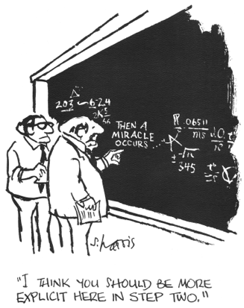
CS7CS6 – Research Rigour
“Rigorous (“trustworthy”) research is research that applies the appropriate research tools to meet the stated objectives of the investigation.” http://journals.sagepub.com/doi/full/10.1177/2158244014548178
Research rigour concerns trustworthiness of the research. For us to trust research it should
Have….
Clarity in all aspects (Area(previous work, state of the art), Question, Method, Resources, potential contribution, limitations). The different aspects of the work should link up in a clear way (demonstrate this in the lines of the research workflow diagram)
Be….
Valid- The ability of your method to answer your question with your constraints.
Verifiable- The work can be checked by you and others
Repeatable- leading to generalizability(if appropriate)
Explicit and transparent
Follow….
an appropriate research philosophy, approach and method

Slide 24
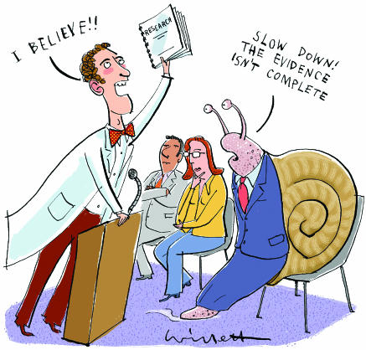
CS7CS6 – Where is the Evidence?
http://evidencebasedliving.human.cornell.edu/2011/12/14/more-evidence-supporting-the-systematic-review/

Slide 25
CS7CS6 – Critiquing papers and dissertations
Critiquing preparation and criteria

Slide 26
CS7CS6 – Taking Notes on Papers/Dissertations
Read purposefully ……. Have an agenda when you are reading.
Create an entry in your reference manager, place the paper in an appropriate group. This will provide the opportunity for you to record, the title, authors, full citation, keywords, full text of the paper, year
The topic of the paper
Concepts and definitions
The aim
The objectives
The scope of the work
Try to identify any assumptions made by the authors
Try to identify any biases – e.g. funding, data set used
Are limitations to the work presented?
Have they used particular data sets in their work?
What references have they based their work on?
What is the most important thing you learnt from the paper
Where does it fit into your research project?
Is it relevant/important/significant for your field of work?
How many citations does the work have?
These notes may prove very useful when you some to deciding what papers to refer to in your proposal/dissertation/assignment.
Create a legend with symbols to mark the papers- e.g. a star for references to follow up on, a circle to mark important sections etc.

Slide 27
CS7CS6 – Critiquing Papers/Dissertations
A critique of a paper is NOT a summary
A summary describes the paper whereas a critique provides a reflection from a variety of viewpoints. The reflection concerns analyses, interpretation, evaluation of the what, why and how of the paper.
When critiquing try not to follow the way the paper is organised as this will probably lead to a summary. Organise your writing according to your reflections on the paper. So, have an initial idea of what you want to reflect on before you read.
Your reflections can be positive and/or negative. A good critique includes your reflections and backs up your impressions with evidence from the paper.
To critique the paper you may need to read it a number of times so that you have a full understanding of it, can reflect on it, consider how it relates to the topic you are studying and other papers you have read and to identify its strengths and weaknesses.
When reflecting on the papers, it can be useful to create a table to capture your thoughts. This can be a useful way of grouping papers and of comparing them which you may need to do in your proposal/dissertation
To guide your discussion, writing, presentation
http://www.uis.edu/ctl/wp-content/uploads/sites/76/2013/03/Howtocritiqueajournalarticle.pdf
https://www.citewrite.qut.edu.au/write/critique.jsp
https://www.wikihow.com/Critique-an-Article

Slide 28
CS7CS6 – Reflecting on the Dissertation
Source
Rigour
Style
Data Management
Findings and Conclusions
References

Slide 29
CS7CS6 – Reflecting on the Paper/dissertation
Consider the paper from the point of view of its source
Peer reviewed paper
Non-peer reviewed
Website
Conference paper
Policy paper
Professional body documents
Standards authorities
Governmental documents
Academic report – for what level/what course
State agencies
Commercial groups
Lobbying/pressure groups
Year of publication
Authors/collaborators and their affiliations, stakeholder mix
Funding agencies.
Is the source a national/regional/international
What is your evaluation of the source?

Slide 30
CS7CS6 – Reflecting on the Paper/dissertation
Consider the paper from the point of view of its Rigour
Is the research presented a valid piece of work? i.e. Is the research design appropriate for the aims of the work?
Is enough information, clarity, transparency given so that the work could be repeated by others?
Is the work carried out in a reliable way? Do spot checks on the calculations.
Trace the logic of the argument presented and determine if the evidence leads to the conclusions drawn. Pay attention to sentences that indicate that conclusions are being drawn- e.g. therefore, it follows that…
Cross check with other papers of a similar type. Does it vary from the other literature in the area? Try to see why?
Is there evidence to support claims?
Are the limitations and assumptions expressed?
What is your evaluation of the rigour?

Slide 31
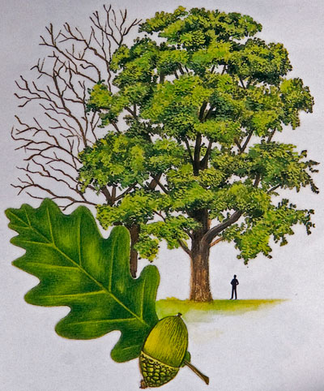
CS7CS6 – Oak Trees take time to Grow
Knowing where to plant acorns?
Dr. Richard W. Hamming
http://www.cs.virginia.edu/~robins/YouAndYourResearch.html
https://treecouncil.ie/project/oak-sessile/

Slide 32
CS7CS6 - Reflecting on the Paper
Consider the paper from the point of view of its Style
Is the work engaging
How well is it written
Have both the subject of interest and the method been introduced clearly?
How is it organised- do the titles of sections match the content of the sections, Is there repetition?
Are all stages of the method explained clearly
Is the text appropriate for the intended audience
Have the important terms been defined clearly
Is the title of the article appropriate, clear and relevant?
Does the abstract describe what the rest of the paper is about.
Is there any ambiguity in the paper e.g. in terms used.
Have the findings been presented clearly?
Are all diagrams, tables, figures clear and referred to from the text.
What is your evaluation of the style?

Slide 33
CS7CS6 – Reflecting on the Paper/dissertation
Consider the paper from the point of view of its Data management
The data for a research project could be a dataset and/or it could be data collected from participants in a study. Consider both types of data.
Is the data collected by the researcher– how is it collected (survey, experiment, interview, case study, focus group).
Is the data collection method valid, i.e. is it correct/useful for the intended use of the data, has ethics been mentioned?
If the data is not collected by the researcher, Where did the data come from?
Is the data used/managed correctly?
Is the data presented clearly and in a useful way?
What is your evaluation of the data management?

Slide 34
CS7CS6 – Reflecting on the Paper/dissertation
Consider the paper from the point of view of its Findings and conclusions
Identify the findings(from literature, surveys, experimentation), limitations and any future work.
Follow the research design and see if the conclusions drawn from the findings are appropriate.
Use any assumptions you noted earlier and see do they have an effect on the findings and conclusions.
Does the conclusions section link to the findings from the literature and the findings from the data? Are new ideas brought into the conclusions.
What is the significance of the findings to the field of work?
How can these findings and conclusions be of use to you?
What is your evaluation of the findings and conclusions?

Slide 35
CS7CS6 – Marking Schemes
Consider the 2 marking schemes on the following slides.
What observations can you make about them?
How will your assignments and dissertation be assessed?

Slide 36
https://www.dcu.ie/sites/default/files/maths/SE4-project-marksheet-nov-2014.pdf

Slide 37
http://www.dit.ie/media/teachertraining/case0052-project/Thesis%20Marking%20Scheme.pdf

Slide 38
http://www.dit.ie/media/teachertraining/case0052-project/Thesis%20Marking%20Scheme.pdf

Slide 39
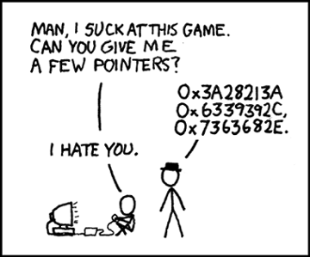
That’s All Folks Thank You for Listening

Slide 40
https://www.tcd.ie/calendar/graduate-studies-higher-degrees/section-I.pdf

